Slide 1

Financial Risk Management - Volatility Estimation and Tail Risk Forecasting
Jonas Bahmann
Levente Mihalyi
Eliseo Carrasco Krämer

Slide 2
Objective & Methodology Outline
Financial returns show volatility clustering and non-constant variance. Risk management requires accurate volatility estimation nad robust tail risk measures. In this project, we will generate a time-series according to the SMV-approach and implement different models.
Methodology
1. Generating time-series with the SVM
2. Implementation of the Kalman Filter
3. MLE for parameter estimation
4. EGARCH-Modell
5. Risk metrics – VaR , ES
6. Comparison & Visualization

Slide 3
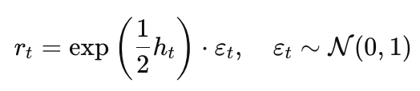

1.0 Generating time-series - SV-Model
The Stochastic Volatility Model (SVM) allows volatility itself to evolve randomly over time.
Volatility is treated as a latent (unobserved) stochastic process, not a deterministic or fixed value.
Measurement Equation
State Equation (log-volatility)
h_t (latent log-volatility) : follows an AR(1) process, allowing smooth evolution over time
Parameters phi and sigma_eta control persistence and volatility of volatility

Slide 4
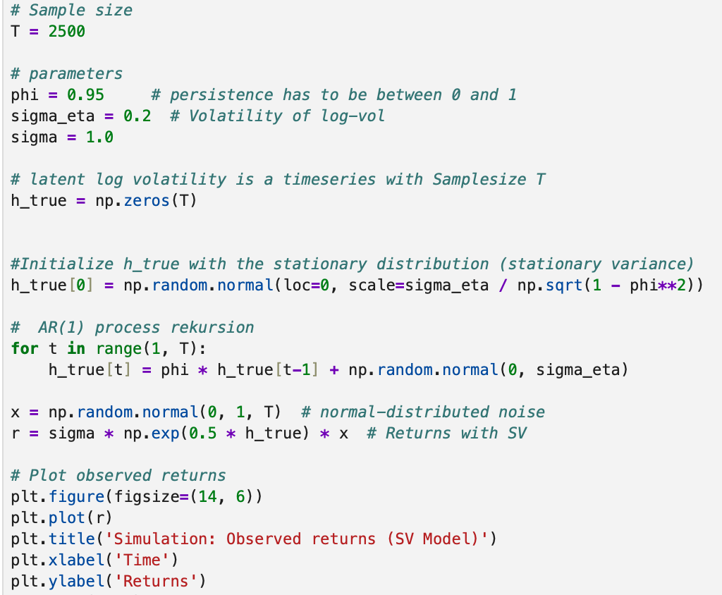
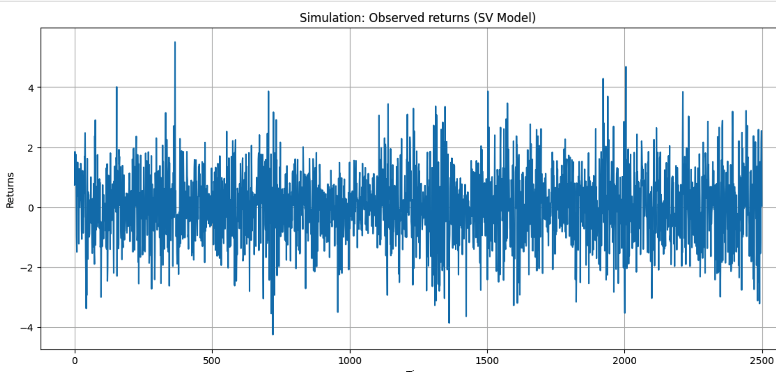
1.1 time-series simulation Are our returns normally distributed?
The volatility is stochastic, meaning it's not directly observed and changes unpredictably.
Captures volatility clustering: high-volatility periods tend to follow each other

Slide 5




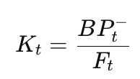

2.1 Kalman Filter - Implementation
Recursive algorithm for linear state-space models
→ Key steps: Prediction(forecast next stept), Update(Adjust usting observations)
Goal: Estimates unobserved states (h_t) form noisy data
1. Prediction (our best guess before seeing the observation)
→ Predict next state and uncertainty
2. Update (Measurement Correction)
→ Calculate prediction error and innovation variance
→Compute Kalman Gain (= trust in new data) => minimizes MSE
→ Update new state and its uncertainty

Slide 6
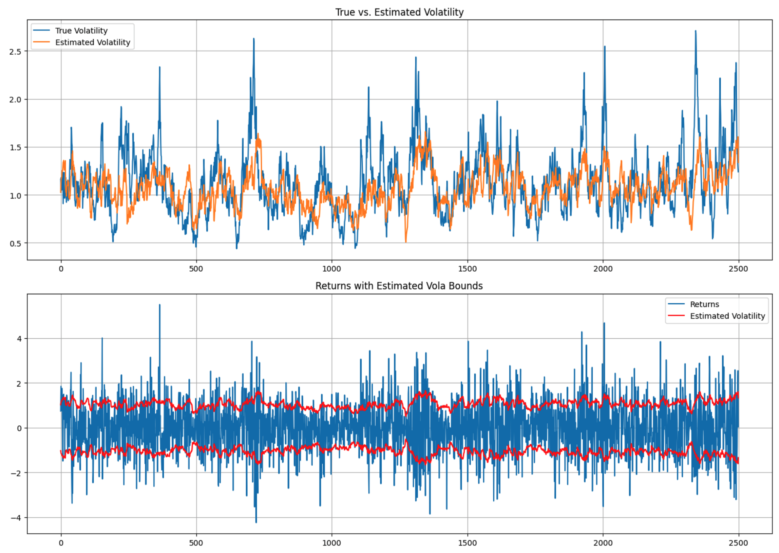
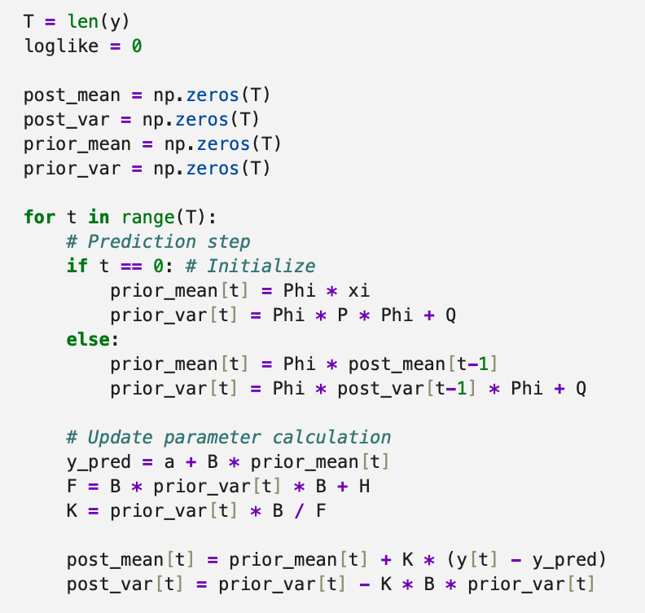
2.2 Kalman Filter - Implementation
SVM isn‘t linear → Solution: Take the log of squared returns → now linear, apply Kalman (y = np.log(r**2))

Slide 7

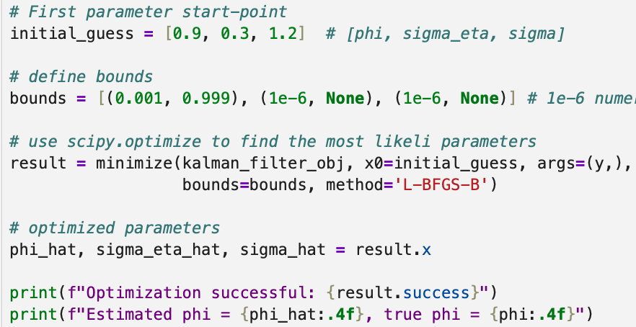



3.0 Estimating Params with MLE
Estimate params by maximizing the likelihood of the observed data, using the Kalman filter to compute the likelihood
Initial guess: phi = 0.9, sigma_eta = 0.3, sigma = 1.2
Constraints:
0 < phi < 1 (stationarity)
sigma_eta > 0, sigma > 0 (variances must be positive)
Algorithm:L-BFGS-B using the scipy-package
Apply Kalman filter to compute log-likelihood and optimize:
Outcome:
These are compared to simulation truth to check estimation accuracy

Slide 8
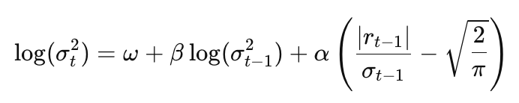
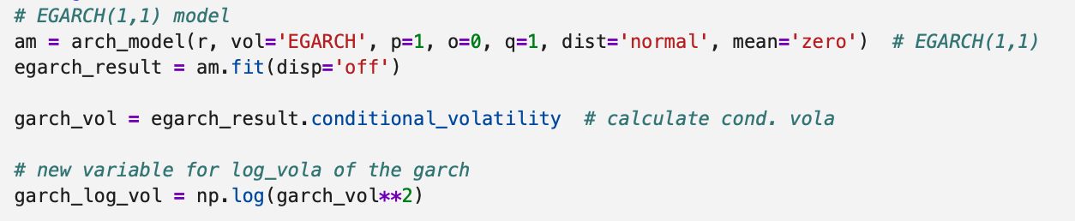
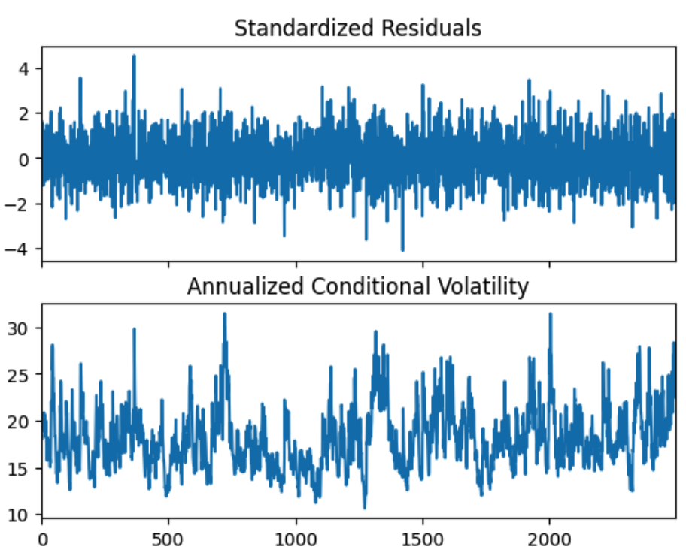
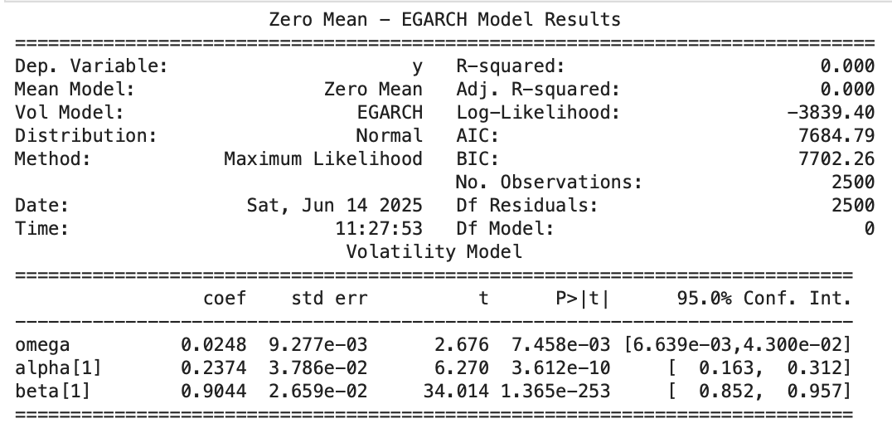
4.0 EGARCH Model
Modeling the logarithm of the conditional variance to capture asymmetric and nonlinear volatility dynamics in financial time series.
In financial markets, negative returns ("bad news") often cause more volatility than positive ones of the same size
The EGARCH(1,1) model defines log-variance as:
omega: long-run average of vola; beta: persistence of vola; alpha: magnitude of volatility's response to new shocks

Slide 9
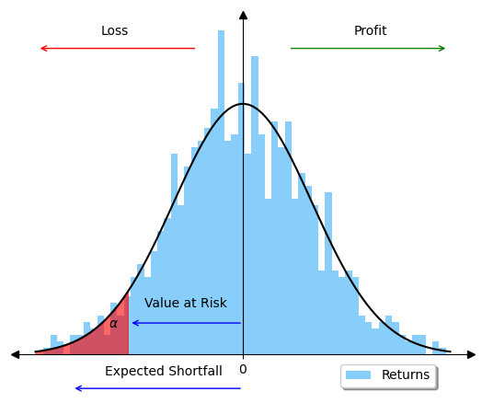

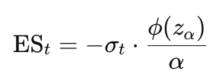
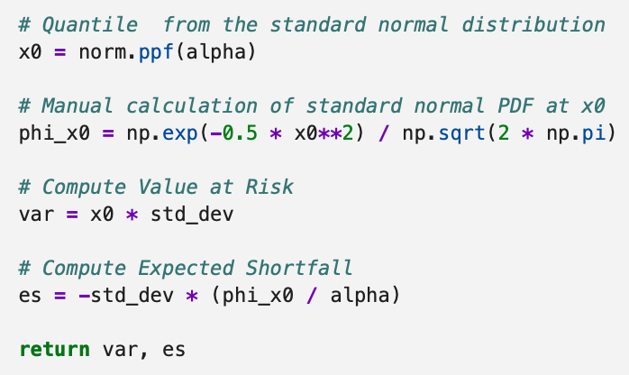
5.0 Risk-Metrics VaR, ES
Financial markets are prone to extreme losses (so-called black swans).
Risk managers need tools to quantify potential worst-case losses.
Value-at-Risk (VaR)
The maximum expected loss at a given confidence level
Example: “At 95%, the portfolio won’t lose more than X on a typical day”
Expected Shortfall (ES)
The average loss if the VaR threshold is breached
More conservative and sensitive to tail behavior
VaR: How bad can it get — with a fixed probability?
ES: If it gets worse than that — how bad is it on average?

Slide 10
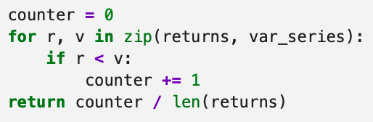
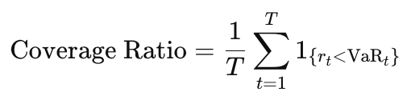
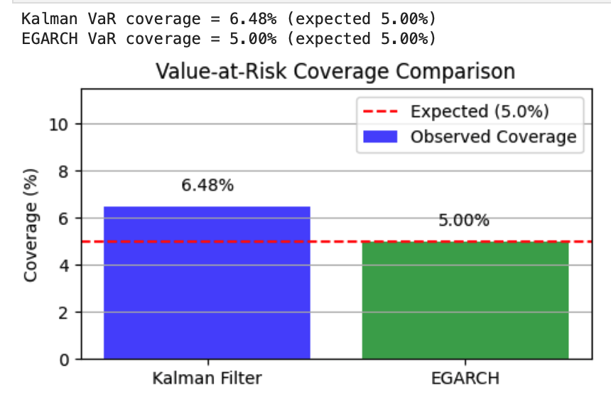
6.0 Coverage Ratio
Purpose: Tests the calibration of a VaR model and compares the exceedance rate to an expected level
It measures how often observed returns r_t fall below the predicted Value-at-Risk:
If the coverage is approximately equal to the expected level (in our case 5%) the model is well-calibrated
If the coverage is higher than expected, the model underestimates risk
If the coverage is lower than expected, the model is too conservative
Results
EGARCH model → Coverage = 5.00% → Matches expected alpha = 5%
Kalman SV model → Coverage = 6.48% → Slightly underestimation of risk

Slide 11
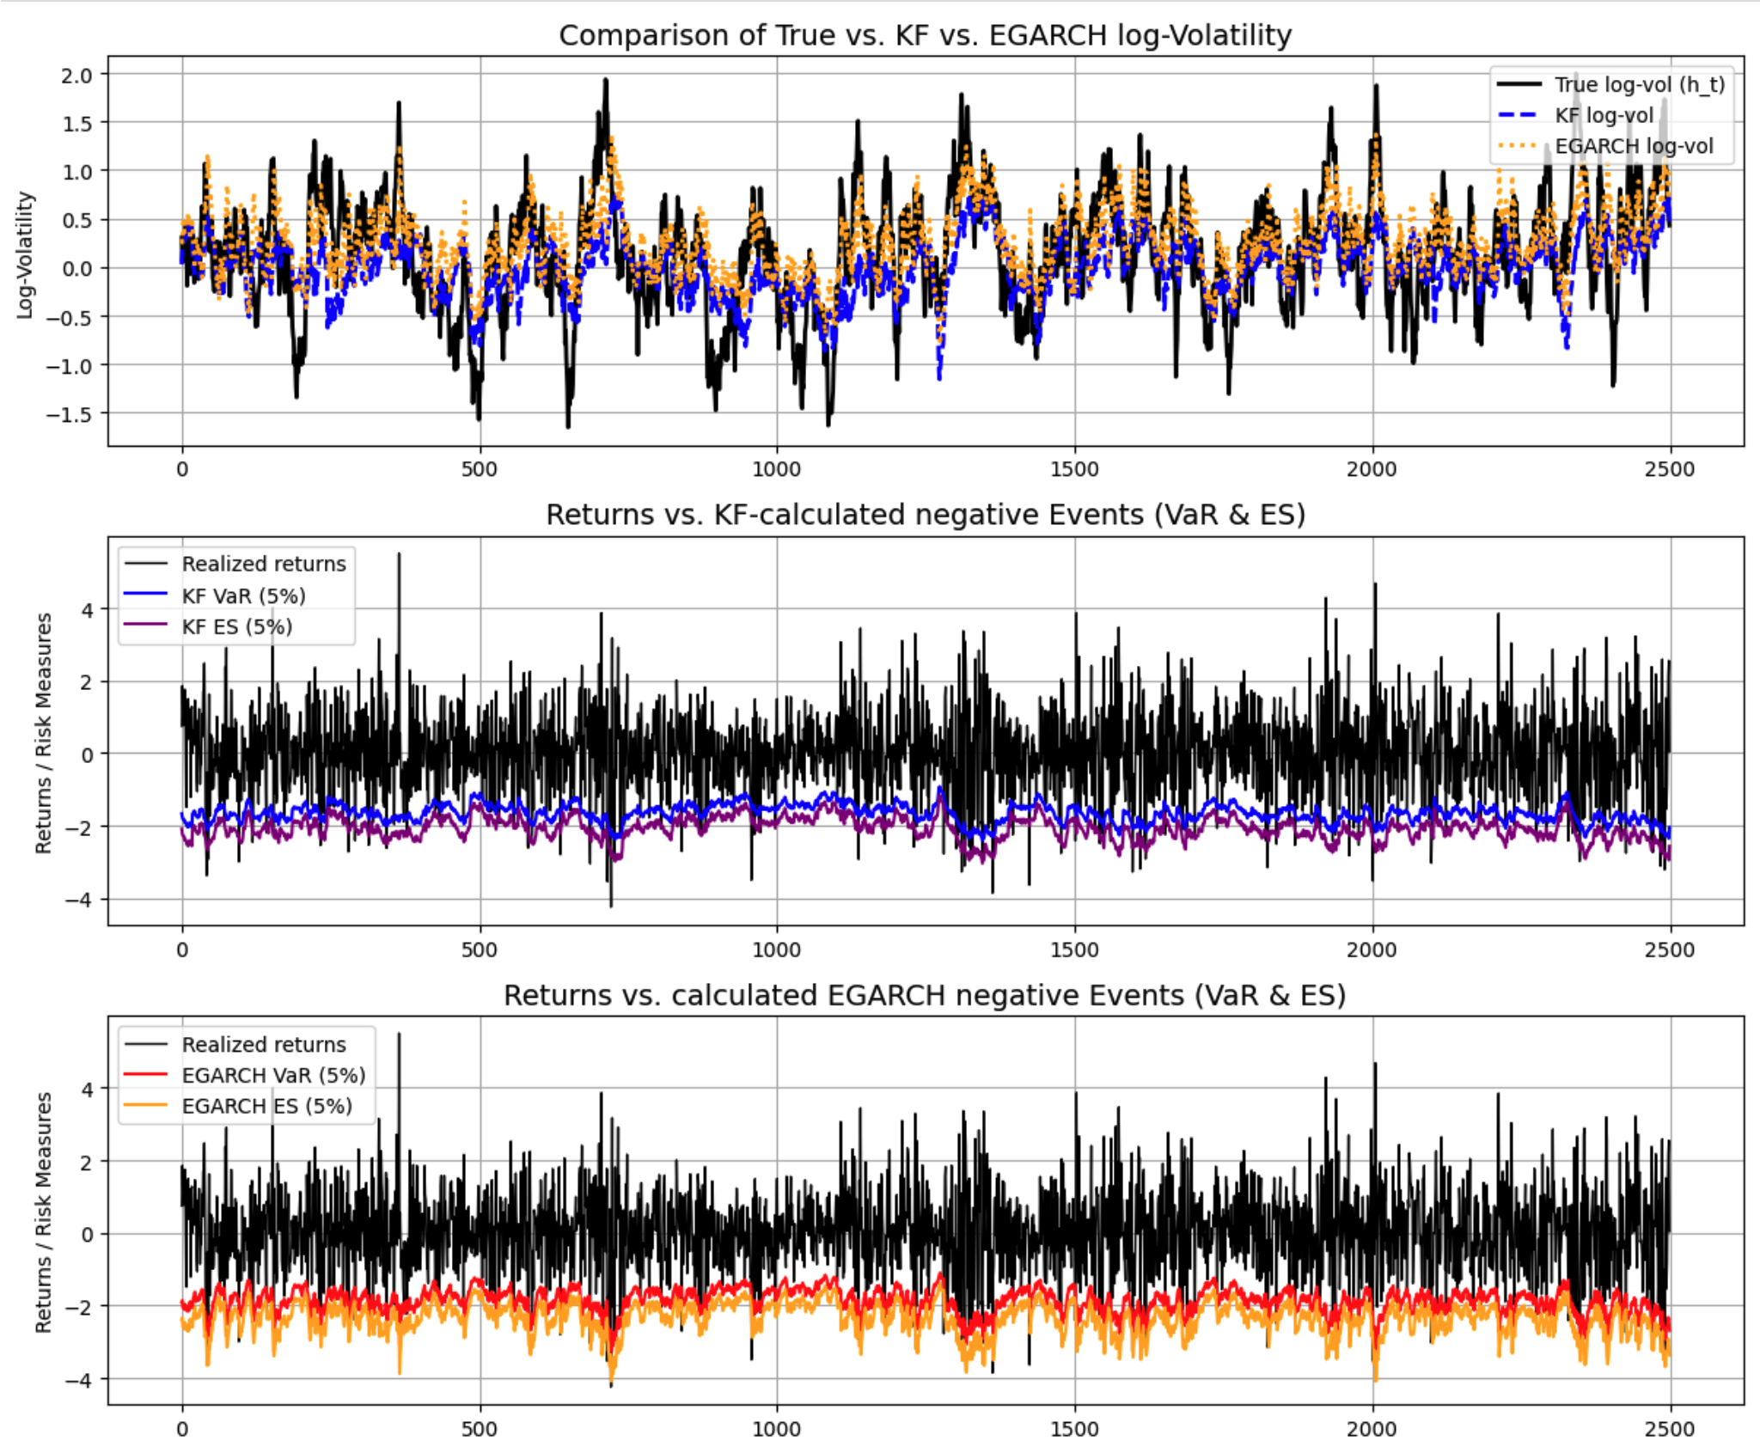
7.0 Comparison and Interpretation
Plot 1: Log-Volatility Comparison
True latent log-volatility (black)
Kalman estimate (blue dashed)
EGARCH(1,1) estimate (orange dotted)
Both models capture general volatility behaviour
Kalman filter reacts more sharply to extreme losses
Plot 2: Returns vs. Kalman-Based VaR & ES
Actual returns
VaR (blue) and Expected Shortfall (lila) from Kalman
Spikes in returns coincide with wider risk bands
→ reflects increased uncertainty
Kalman-based risk metrics are adaptive and responsive.
Plot 3: Returns vs. EGARCH-Based VaR & ES
VaR (red) and ES (orange) are smoother
Captures volatility clusters well, but reacts less aggressively

